Slide 1
C++ allows for nonsense, and that’s great
Justin Tremblay

Slide 2
Who am I?
4th year software engineering student at McGill
Interned at:
Eidos Montreal, Gameplay, Shadow of the Tomb Raider
Eidos Montreal, Tools, [insert game title]
Genetec, Omnicast
First started using C++ in 2014, in CÉGEP
Into Game Engines and Compilers
This is my first tech talk!

Slide 3
Disclaimer
This code is my own creation, although it may be similar, it is not the same as the code that was written as part of my internship at Genetec.

Slide 4
Some Background
During my last internship, I was given the task to implement a library to log ETW traces.
Introduced in Windows 10, the TraceLogging library builds on top of the ETW technology, which was introduced in Windows 2000.
Very low impact on your program’s runtime performance.
You said nonsense, where’s the catch?

Slide 5

It’s all macros!
Most of the library is implemented as macros.
Most likely to preserve backward compatibility with other Windows versions.
This is nonsense! Macros are evil! Why would anyone ever implement a whole library as macros?!

Slide 6
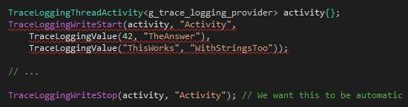
It’s all macros!
Another annoying restriction: whenever a name must be given, it MUST be a string literal, not a variable.
Also, resharper doesn’t like the TraceLoggingValue macro (even though it compiles).

Slide 7
The Goal
Make it easy to log an ETW activity.
It has to be a “one-liner” for the devs using it.
Automate the “Stop” event (One-liner)
The type of activity I’m using (TraceLoggingThreadActivity) actually stops automatically at the end of the scope, but the event isn’t very descriptive.
But how do you wrap around a macro that requires a string literal to be passed?
How do you automate the call to TraceLoggingWriteStop at the end of the scope?

Slide 8
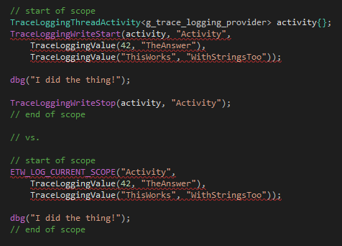
The Solution: More Nonsense!
Before:
After:

Slide 9

Implementation
Passes the string literal “name” to the TraceLoggingWriteStart and TraceLoggingWriteStop calls.
Captures the local scope by reference so that you can use local variables in the variadic arguments list.

Slide 10
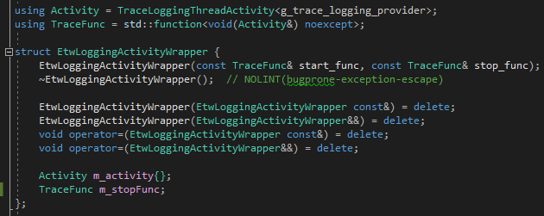
Implementation

Slide 11
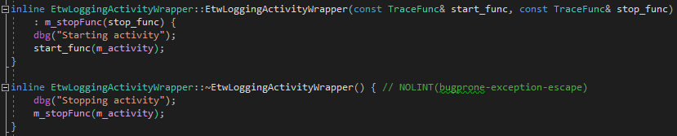
Implementation
Calls “start_func” upon construction and “stop_func” upon destruction

Slide 12
What I’ve learned
Macros are evil, but sometimes necessary.
Sometimes the solution to a problem seems silly, but it’s the right one.
C++ allows for complete nonsense, and that’s great!

Slide 13
Thank you for listening!

Slide 14
References
TraceLogging quickstart and documentation:
https://docs.microsoft.com/en-us/windows/win32/tracelogging/tracelogging-native-quick-start
“dbg” macro used in code:
https://github.com/sharkdp/dbg-macro
Code and (soon) slides/write-up available at:
https://github.com/L3gume/ETWTracing

